Slide 1
PPT Advanced Training

Slide 2
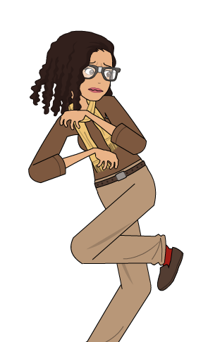
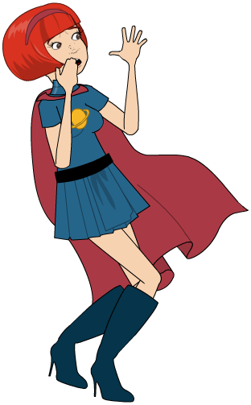
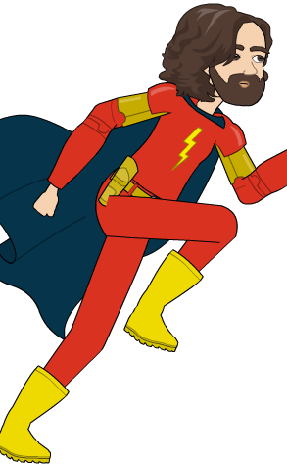

Slide 3
Store Add-ins
Insert Ribbon
Add-ins
Store
“Best Apps of the Year”

Slide 4
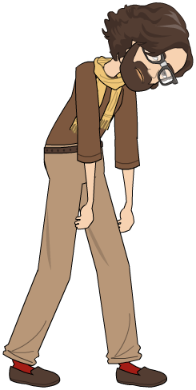

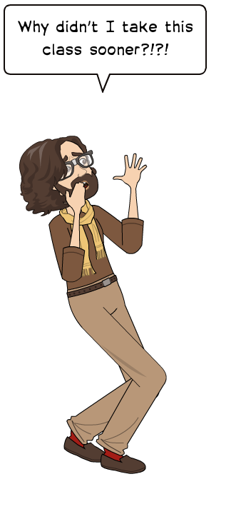
Add three images from Comic Characters

Slide 5





Emoji practice
How happy are you today
Notes:
How to group and ungroup

Slide 6
Store Add-ins
Insert Ribbon
Add-ins
Store
Search “Emoji”

Slide 7


Slide 8


Slide 9
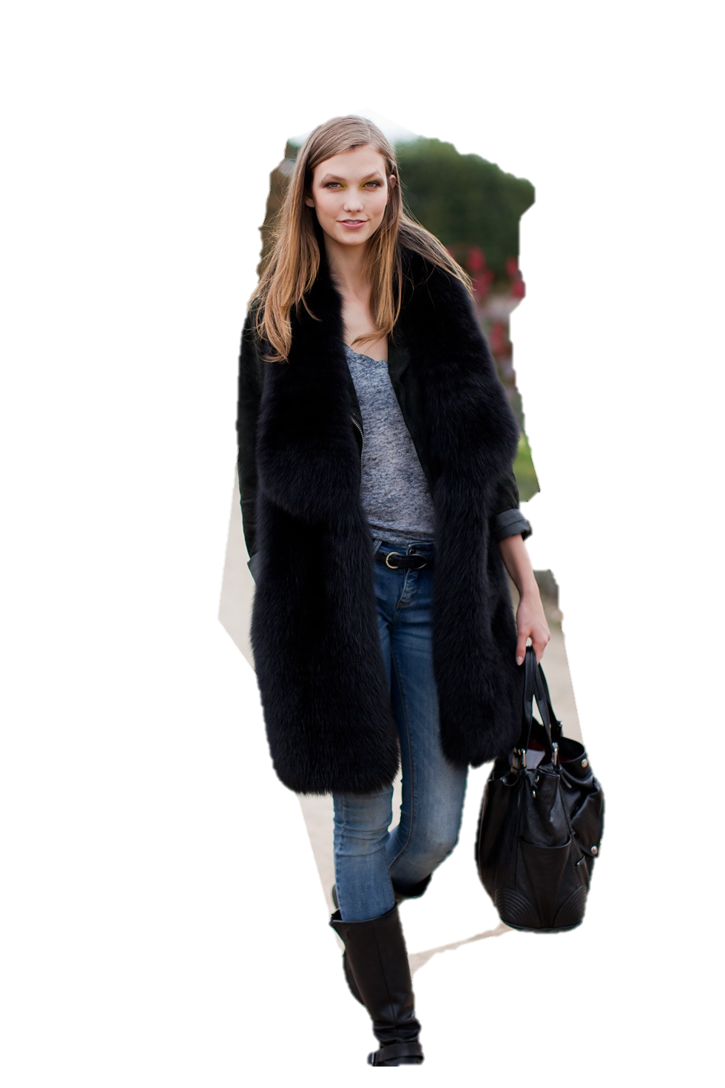
Individual practice:
Remove the background,
Past the model onto the previous slide

Slide 10

This Photo by Unknown Author is licensed under CC BY-NC-ND

Slide 11
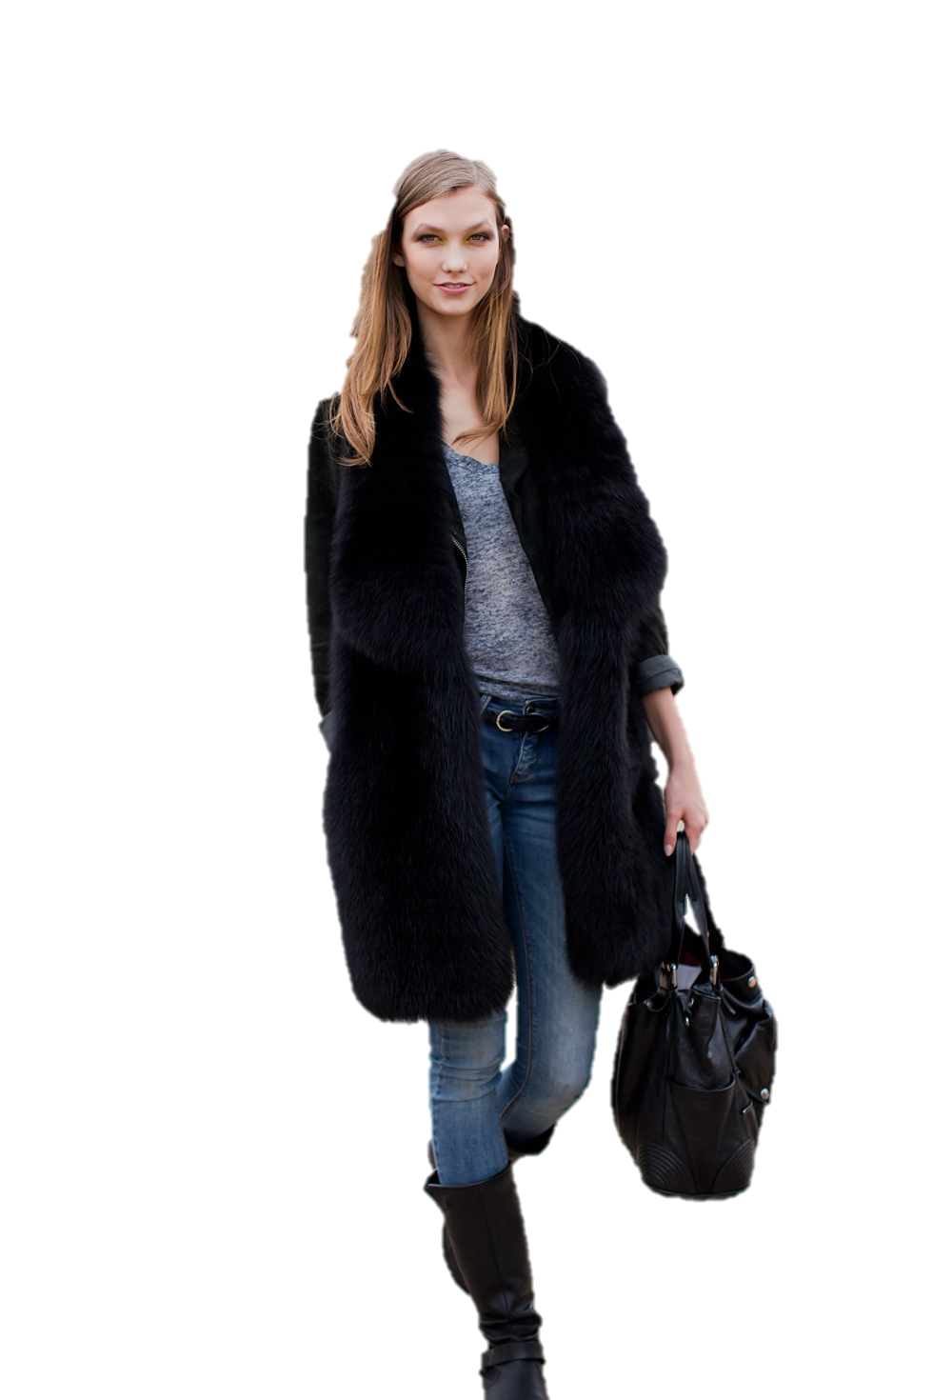
This Photo by Unknown Author is licensed under CC BY-NC-ND

Slide 12
USFCA Academics (2016)
Student/Faculty Ratio: 14:1
Bachelor's Degrees Awarded: 1,695
Master's Degrees Awarded: 1,356
Doctoral Degrees Awarded (including Law): 222
Four-year Graduation Rate: 61.6%, for freshmen entering fall 2010
Notes:
Regular bulleted list (Boring)

Slide 13
USFCA Academics (2016)
Student/Faculty Ratio:
Bachelor's Degrees Awarded:
Master's Degrees Awarded:
Doctoral Degrees Awarded (including Law):
Four-year Graduation Rate:
  14:1
  1,695
  1,356
  222
  61.6%

Slide 14
USFCA Academics (2016)
Student/Faculty Ratio:
  14:1
Bachelor's Degrees Awarded:
  1,695
Master's Degrees Awarded:
  1,356
Doctoral Degrees Awarded (including Law):
  222
Four-year Graduation Rate:
  61.6%

Slide 15
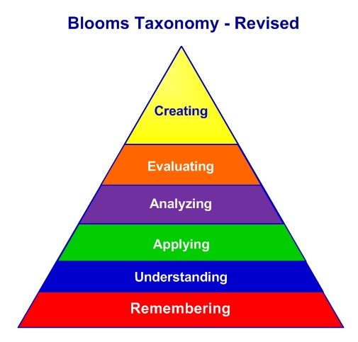
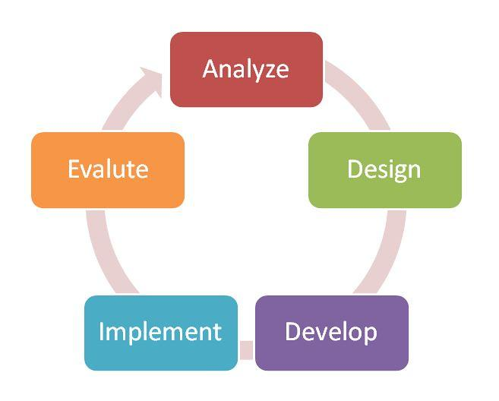
Practice: Create one of the smart art
ADDIE Model

Slide 16
ADDIE MODEL
Analysis
Design
Development
Implement
Evaluation

Slide 17


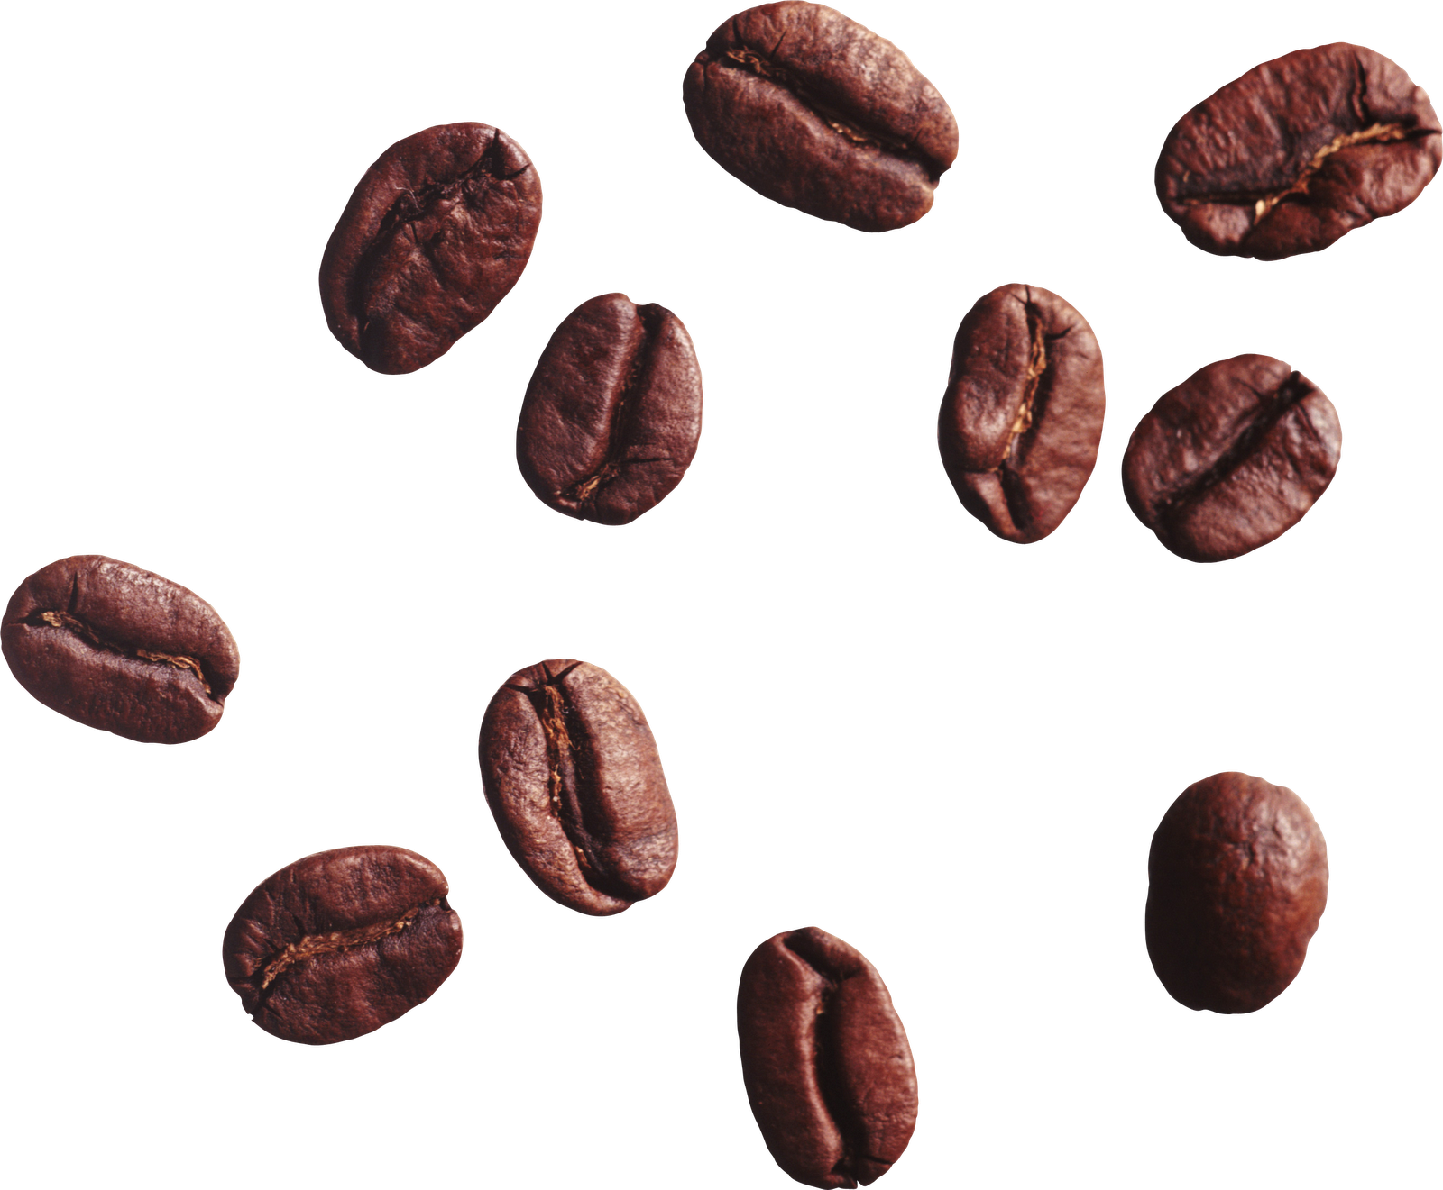
Notes:
3D Morph Parallax

Slide 19
3D Morph Parallax

Slide 20
Crop Crop Crop
3 small sized beans
3 medium sized beans
3 large sized beans

Slide 27

Introduction
Statement of the problem
Significance of the research
This Photo by Unknown Author is licensed under CC BY-SA-NC
Notes:
If you've already jotted down an outline of your presentation in Word and now need a quick way to add it to your slides, you can import a Word outline into PowerPoint.

Slide 28
Literature review
Instruction design
The use of Technology in Education
This Photo by Unknown Author is licensed under CC BY-SA-NC

Slide 29
Methodology
Participants
Data collection
This Photo by Unknown Author is licensed under CC BY-SA-NC

Slide 30
Results
Data analysis report
Implications
This Photo by Unknown Author is licensed under CC BY-SA-NC

Slide 31

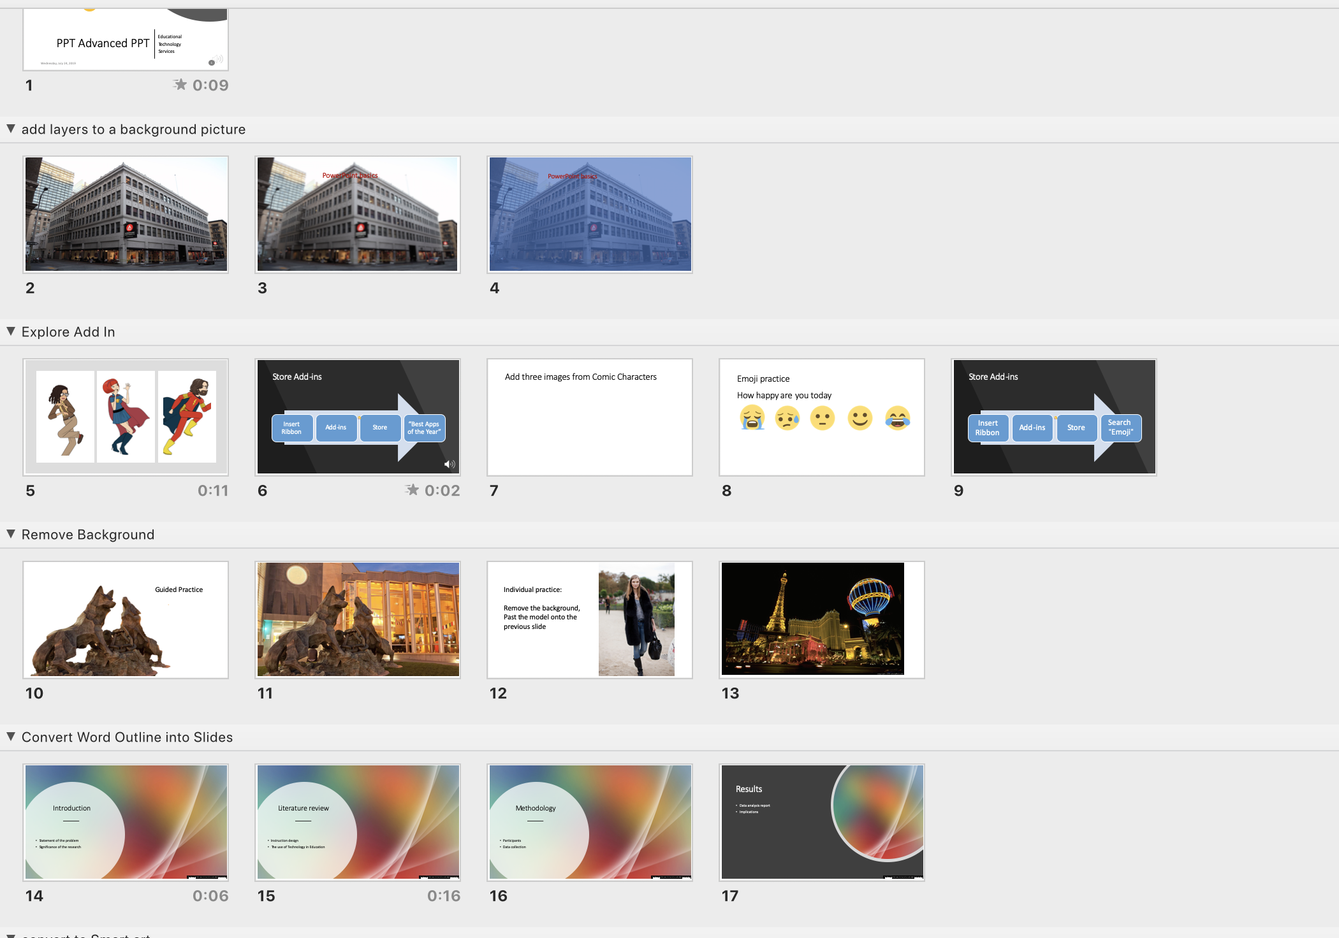
Organize your presentation
Notes:
Remove section

Slide 32
Organize your presentation
Multi-select the slides (shift + select)
Right click
Click Add to Section
Name the Section
Notes:
Remove section

Slide 33
Organize your presentation
Q & A
Rename Section??
Move a slide to other section??
Copy a Slide to other section ??
Delete section ??
Move a section around ??

Slide 34


Record Slide show
Go to View
Click Slide Sorter
Choose the slide that you wanna record
Click Slide show in the tab ribbon
Click Record Slide Show
Notes:
? Record any slide
? Delete- what you have record
? re-record

Slide 35
Presenter View
Go to slide show
Click Presenter View
Notes:
Save and print

Slide 36


